Slide 1
AM2 project update
Oliver Lyttleton 07/04/2026

Slide 2
I work for CLOSER…
The CLOSER project collects a large number of questions and variables from UK longitudinal population studies. We enable researchers to discover data of interest by using a web portal to browse questions and variables, or by querying a REST API to get data programmatically from the repository our data is stored in.

Slide 3
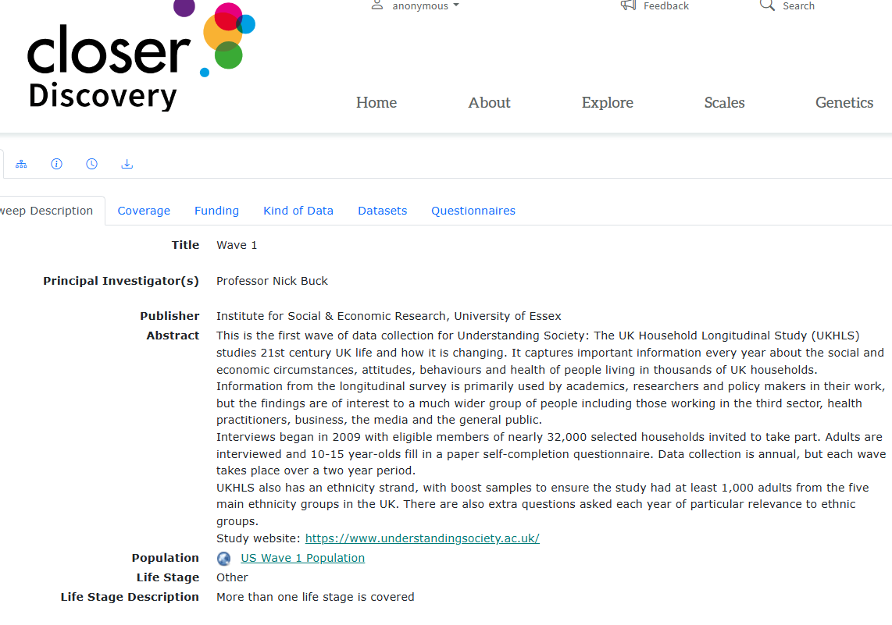
This is the website (discovery.closer.ac.uk) used to explore our data. Here is a study, it references items such as datasets, questionnaires, etc. Those items reference other items as well.

Slide 4
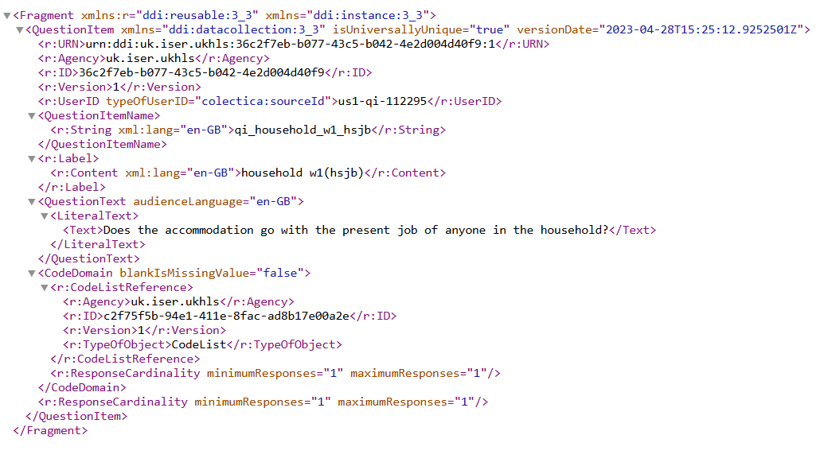
Items are described using DDI-XML. Here is a question item, note that it has a ‘CodeListReference’; the codelist represents the multiple choice options for the question. Our REST API can be used to get this XML data.

Slide 5
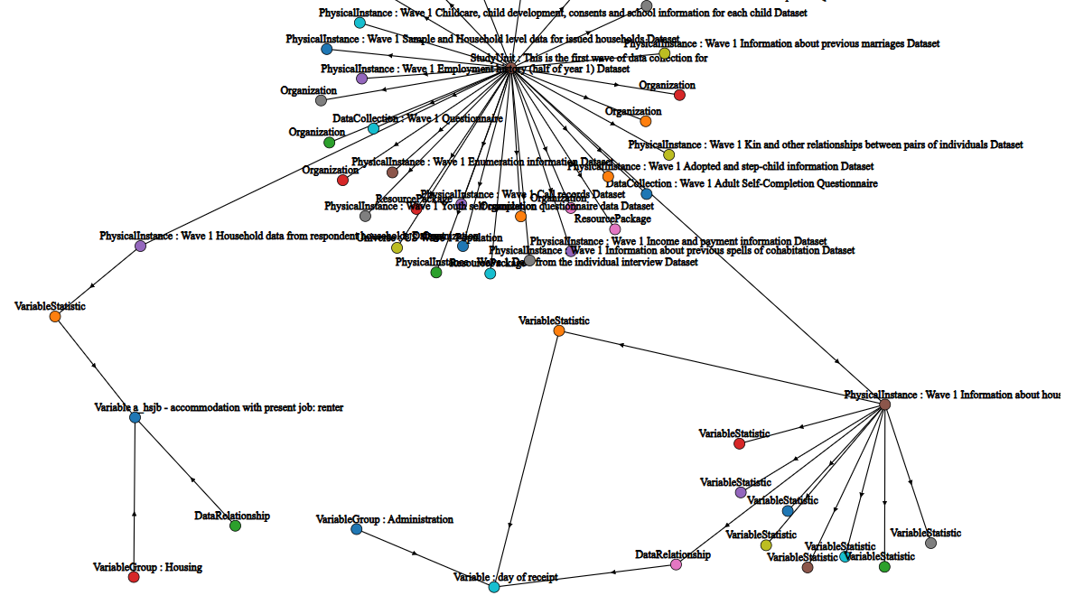
Our data is like a graph database: items are nodes, and can reference each other…

Slide 6
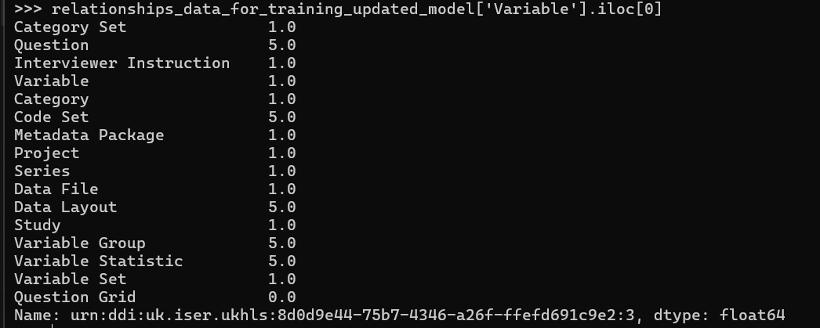
You can represent the relationships that an item has with other items as a vector of numeric values. Below is an example of the relationships that a variable has with other items: (5=directly references, 1 = transitively/indirectly referenced i.e. Variable Set->Variable Statistic-> Variable, 0 = no relationship)

Slide 7
We want to find ‘anomalies’…
We want to find items which are ‘anomalies’; they’re either connected to another item they shouldn’t be, OR they’re not connected to an item that they should be.
Anomalies cause problems in the web front end (items aren’t displayed correctly, items can have missing information, or irrelevant/confusing information, etc.)
Anomalies also cause problems when executing queries against the REST API we use to expose our data; if there isn’t a direct path from one item to another, certain queries won’t work. For example, a variable item that isn’t referenced by a dataset item won’t be returned in a query that requests all the variables in that dataset.

Slide 8
Why do we need ML for this?
Hard-coding rules for all potential anomalies is too time-consuming and difficult. There are too many potential relationships between items/item types, it’s too time consuming to create and maintain this list of rules. It also requires ‘expert knowledge’ that CLOSER staff may not have; we may not know that a certain relationship between items is required or problematic. The DDI-XML datatypes and schemas used in our system may change over time, requiring us to continuously create new rules, or abandon old rules.
Also, it’s important to remember that an outlier is NOT the same as an anomaly – just because an item has an unusual relationship with another item type, doesn’t mean that’s a problem. In our context, unusual is not equal to anomalous.
Could an ML model can be used to predict anomalous items from existing data?

Slide 9
Can an ML model be trained to predict if an item is anomalous/broken using a set of samples representing item relationships like we saw before? Maybe, but: the item data isn’t labelled as anomalous/non-anomalous…

Slide 10
Solution: create a pseudo-labelled training dataset for a supervised learning model…
We can create a pseudo-labelled training dataset for a supervised learning model using PCA, IsolationForests and a ‘human in the loop’
We take the data representing item relationships, and perform dimension reduction by using PCA. We identify outliers in the pca data using a IsolationForest. A ‘human in the loop’ examines those outliers and confirms whether they are genuine anomalies OR if they’re just items that are unusual.

Slide 11
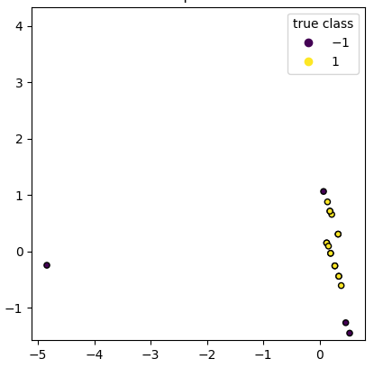
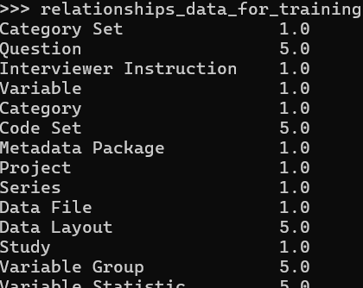
So we can go from a set of numeric vectors representing item relationships, to a PCA plot which shows outliers identified using an IsolationForest, which a human can inspect for anomalies.

Slide 12
We don’t just want to find outliers/items with unusual relationships…
Just because an item’s relationships with other items are unusual, doesn’t mean it’s an anomaly/there’s a problem with it.
Example: https://discovery.closer.ac.uk/item/uk.cls.bcs70/2b38f0a1-8f31-4417-a8d3-d2ac1ace986e
This question item has a ‘Related Image’. Most questions don’t have related images. This particular question is unusual in that respect, but there’s nothing wrong/anomalous with it, and it requires no further attention from us.
The ‘human in the loop’ is critical; they will differentiate unusual items from anomalous items.

Slide 13
When we have generated a pseudo-labelled dataset…
A supervised model (e.g. decision tree) is trained on the pseudo-labelled data; the input features are the numbers representing relationships that an item has with other items (as described in previous slides). The target variable (e.g. the ‘IsAnomalyFlag’ value in the example below) are the labels generated by the ‘human in the loop’ by examining the IsolationForests: 0=fine, 1 =anomaly
>>> relationships_data_for_training_updated_model['Variable'].iloc[0]
Category Set 1.0
Question 5.0
Interviewer Instruction 1.
Question Grid 0.0
…
…
IsAnomalyFlag 0.0

Slide 14
Model deployment
We have a batch script that can use the trained decision tree model to detect anomalies (https://github.com/CLOSER-Cohorts/ml-resources/blob/main/projects/am2_project/src/check_for_data.py).
The script checks if there is any new data available in the repository. If there are new items, it generates input features for those items (representing their relationships with other items). Those input features are used as input to the decision tree model, which processes them as a batch.
A CI/CD pipeline ensures that the most up-to-date version of the code is always deployed to a Windows server. The Windows Task Scheduler is used to ensure that the script that checks for new items and flags potential anomalies is executed periodically.

Slide 15
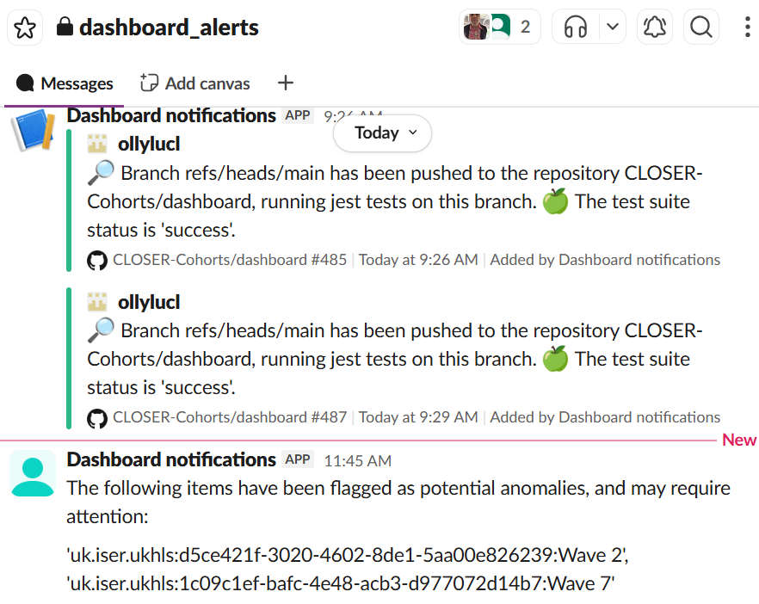
If the decision tree predicts that an item is anomalous, it sends an alert to a Slack channel that is monitored by CLOSER staff…

Slide 16
After being alerted via the Slack monitoring channel…
CLOSER staff can inspect the items flagged by the model and decide what (if any) remedial action should be taken.
They can also record if the model predictions were correct. This information can be used both to calculate performance metrics for the model, and also for creating new datasets for retraining the model.

Slide 17
What have we done, what will we do in future
https://github.com/CLOSER-Cohorts/ml-resources/issues shows what we’ve already done (in the ‘Closed’ section) and what we’re currently working on.
https://trello.com/b/JHist2nG/ai-project also shows what we’ve done/will do in future; it replicates much of the information in the github issue tracker but it also has a backlog of items representing work we will do in future, and it shows the current status of work more clearly

Slide 18
What we could monitor
Model performance – primarily precision. We *might* measure recall, but as we don’t have labelled data that might not be feasible. Accuracy is not a useful metric; we don’t have labelled data and just outputting the majority class in the data will give a very high accuracy.
Data drift – monitor the anomaly score calculated by the isolation forest for the input features (https://scikit-learn.org/stable/modules/generated/sklearn.ensemble.IsolationForest.html#sklearn.ensemble.IsolationForest.decision_function). Gather summary statistics for the anomaly score (e.g. mean/min/max/distribution). Check for data drift/dramatic changes in these summary statistics. We can monitor the number of outliers detected by the Isolation Forest which turn out to be anomalies, and check for sudden spikes.

Slide 19
What we could monitor
System/operational metrics: if the deployed application fails (e.g. the repository goes down,a code/dependency update breaks the application, or an update to data schema used by repository breaks our deployed application), alerts are sent to the Slack channel used for monitoring.
Latencies and item throughput when executing repository requests and obtaining model predictions will also be obtained.
This isn’t an exhaustive list, we can add other things for monitoring as well over time (bearing in mind our deadlines!!!)

Slide 20
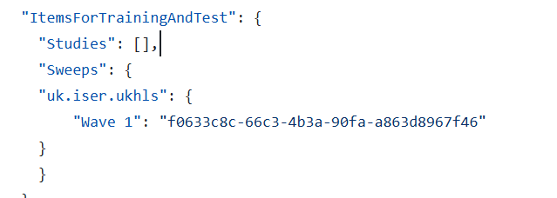
What next: ingesting new data
There are data from 188 sweeps in our repository at present.
Our application has a config file which specifies what sweeps to pull data from (https://github.com/CLOSER-Cohorts/ml-resources/blob/main/projects/am2_project/config/am2_config.json)

Slide 21
What next: ingesting new data
Just because data is in our repository, doesn’t mean it’s in our model! The data that is used to train our model is specified in the’Sweeps’ field in the am2_config.json file referenced in the previous slide.
At present there is only one sweep in this config file. We will add more sweeps to this config file and generate new labelled data from these sweeps that can be used to retrain the model with the addition of each new sweep.
We will observe the monitoring data while ingesting data to ensure there are no problems.

Slide 22
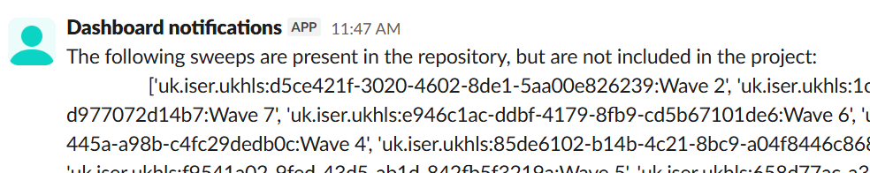
Updating the model with new data
When a new sweep is added to the config file (or items are added/updated in a sweep that is already in the config file), the deployed application obtains the data for this sweep from the repository and sends an alert to the Slack monitoring channel saying that new training data is available.

Slide 23
Training/retraining the model
A human user then uses a Python function I wrote called “train_semi_supervised_model” to create pseudo-labelled training data. When running this function, they will be presented with the graphs showing the output from the IsolationForest and the data for the outliers detected by the IsolationForest. The user will be asked to confirm if the outliers are anomalies that require human intervention. This could be ascertained by viewing the outlier in the Discovery web portal, examining what other items the outlier is/isn’t connected to, etc.
We will use this pseudo-labelled data to train a decision tree which will predict anomalies.

Slide 24
Model validation
We will hold back approx. 20% of the sweeps for model validation.
We also plan on adding data in addition to that already in the 188 sweeps in our repository over the next few months. This new data will be detected by our deployed application, and the model will automatically try to detect anomalies in it.

